Slide 1
Knowledge Graph-Enhanced Vision-Language Models for Radiology Report Generation
Master Thesis Proposal
Antonia Gustke, 460097
Advisor: Yongli Mou, M.Sc.
Supervisor: Prof. Dr. Stefan Decker

Slide 2
Problem Statement
What is missing in radiology reports written by AI?
Unusual grammar and style
Unnatural sentence structure
Repetition and rigid templates
Incoherent statements
=> Linguistic problem, not a medical one

Slide 3
Goal of my thesis
Development of an AI model that:
Is clinically correct (measured separately)
Sounds like a human (evaluated by you)
Focus:
Style
Coherence
Readability

Slide 4
How does an AI model learn to „sound like a human“?
Analogue to humans, a model learns through feedback
A pretrained model creates two reports
Evaluated by human („Which report is better in terms of style, coherence and readablility?“)
Model learns through these preference pairs

Slide 5


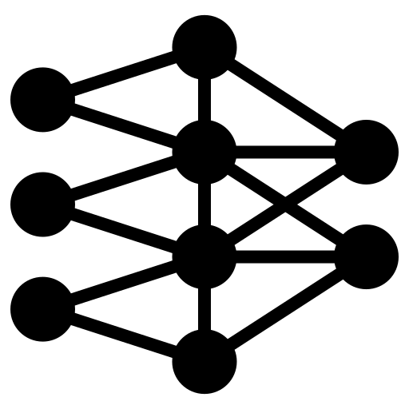

What is Direct Preference Optimization?
Report A
Report B
Report B

Slide 6
How you can help
Procedure per case:
You will see chest x-rays (1-3 per case)
Read two reports corresponding to the images
Select which report sounds more human-like
What is NOT scope of the survey:
Evaluate the diagnosis
Look for errors
Time estimation (proof of concept):
30 - 45 seconds per case
Assuming 3 radiologists
160 cases for the proof of concept
=> 25 - 40 minutes per radiologist
(>10 hours for full dataset for each radiologist)

Slide 7
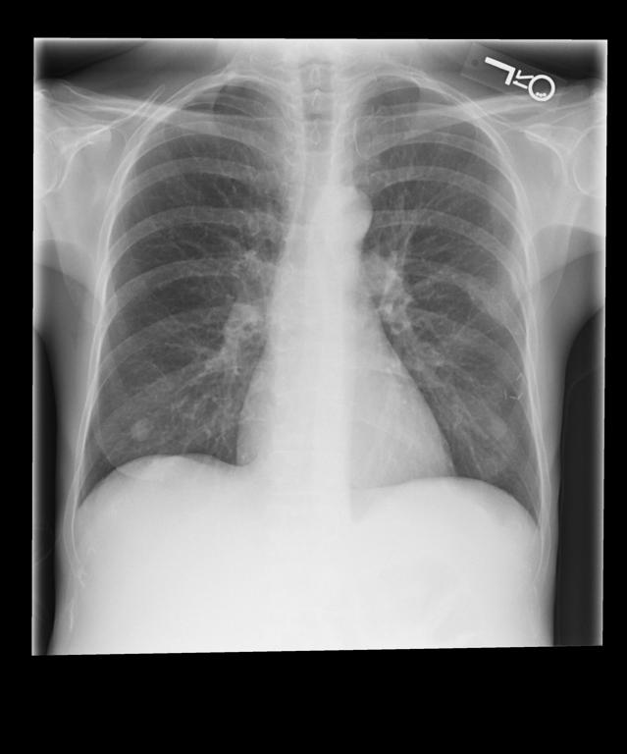
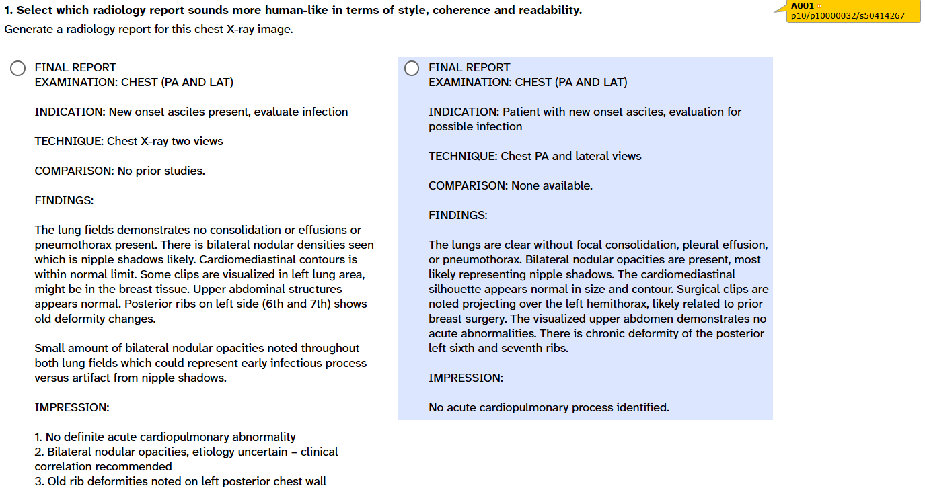
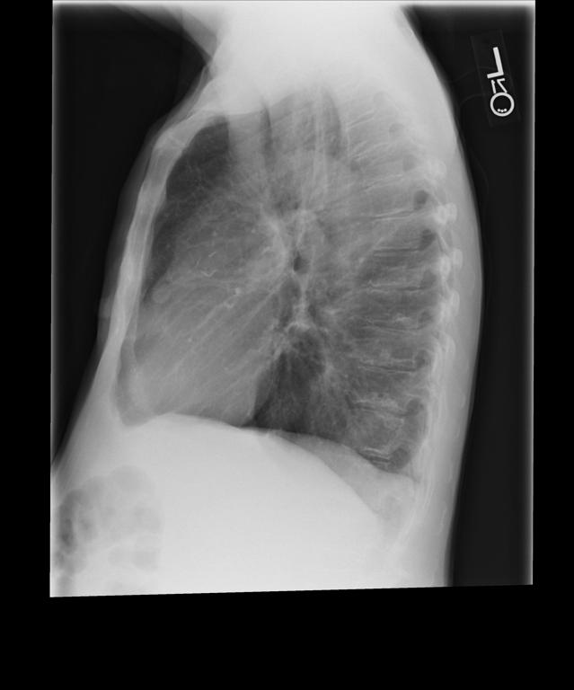
Example case

